Slide 1
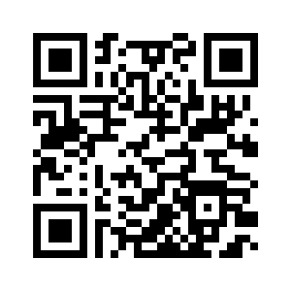
Virtual Concierge
https://github.com/BrassM0nkeyy/virtual-concierge

Slide 2
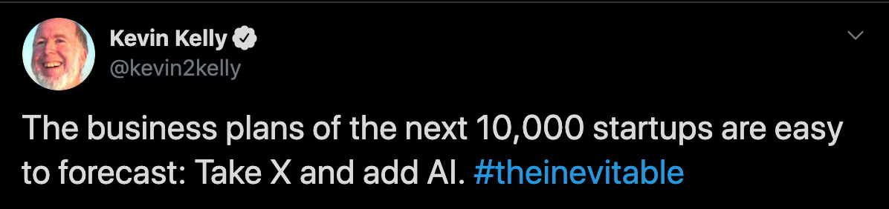
Making things smart
Notes:
what is vitrual concieger problem statement
introduce art school

Slide 3
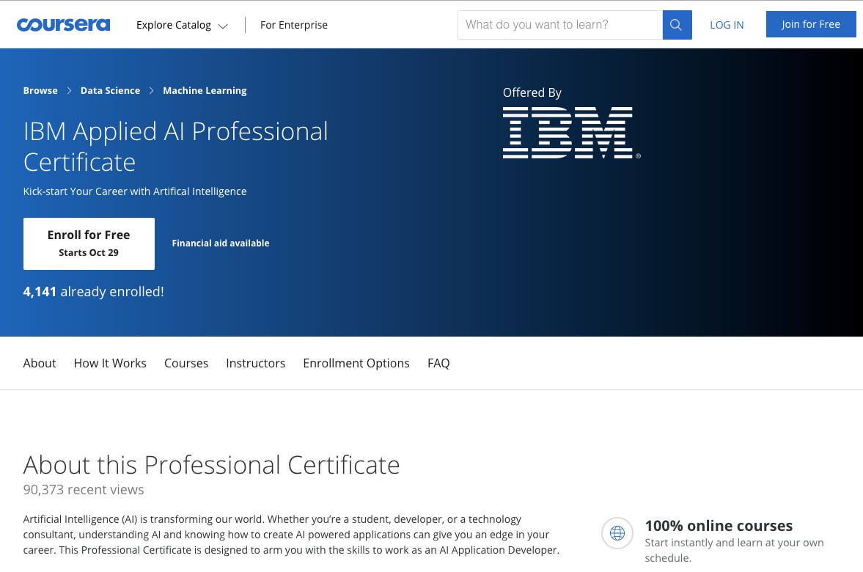
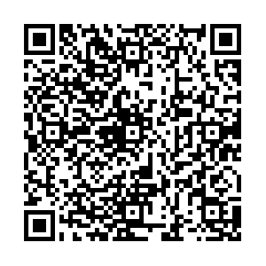

Slide 4

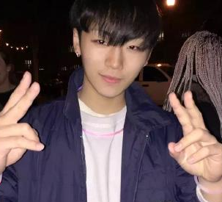



About Us
Eric Quan
Matthew Grech
https://www.linkedin.com/in/shengxu-quan1/
https://www.linkedin.com/in/matthew-grech-6b6a56162/
Notes:
short the link swap us

Slide 5
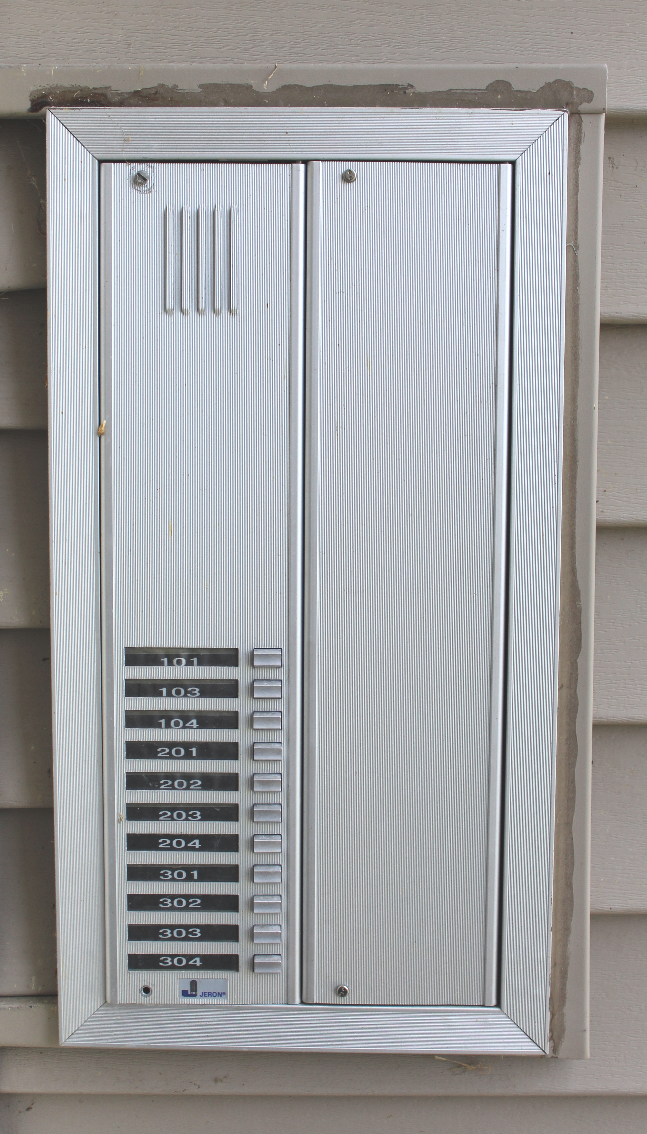
The Problem
Notes:
the problem we trying to solve

Slide 6

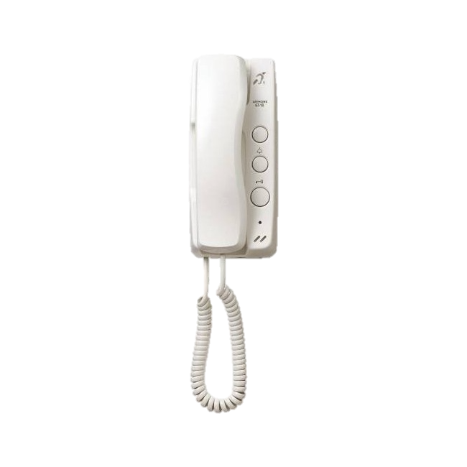

Slide 11
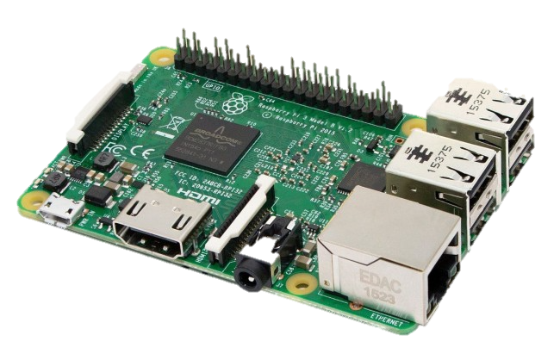

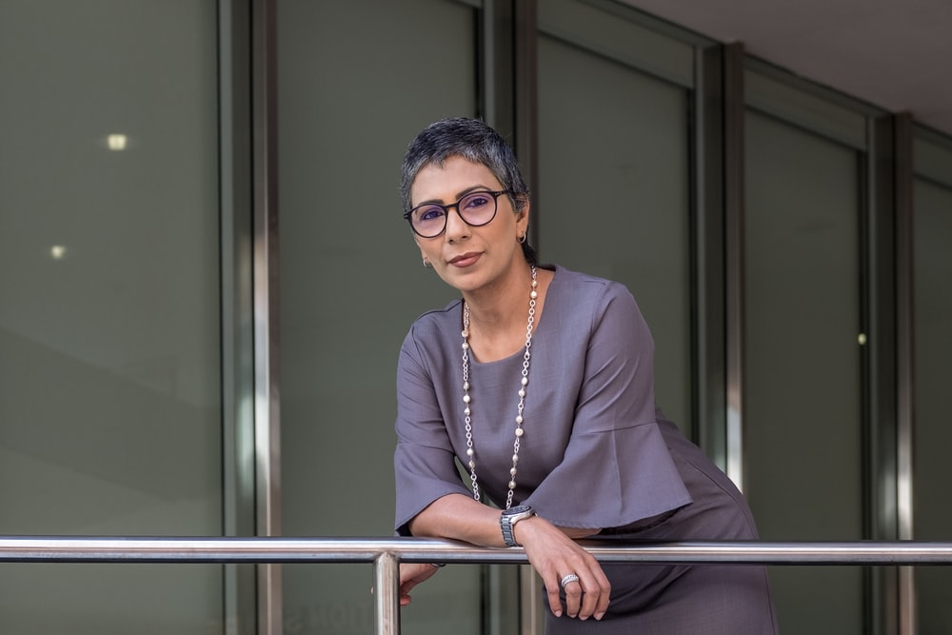


Demo Implementation
Notes:
demo

Slide 12

Uses
Similar implementation is being used for a local art school by our office
Notes:
solution

Slide 13
Tinkering
Opens door
Audio in/out

Slide 14
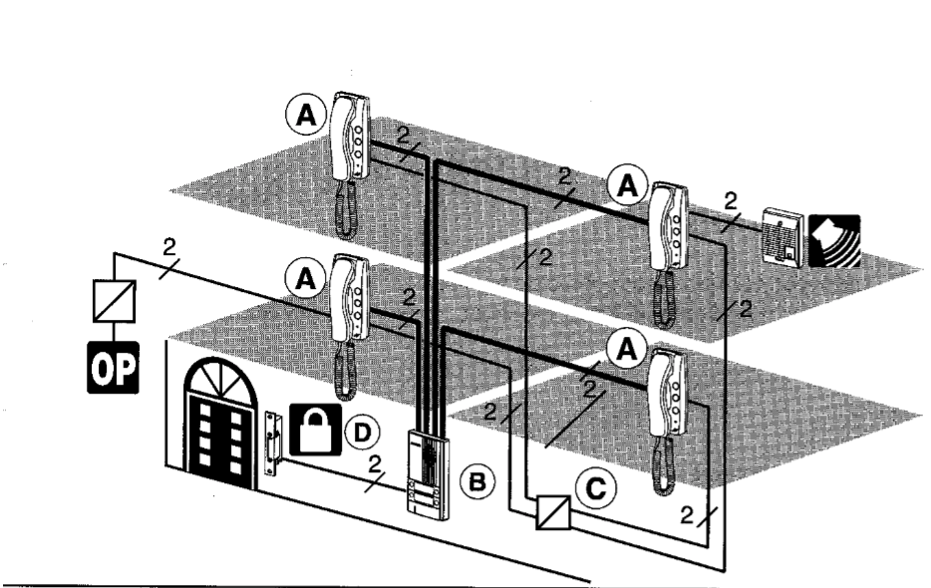
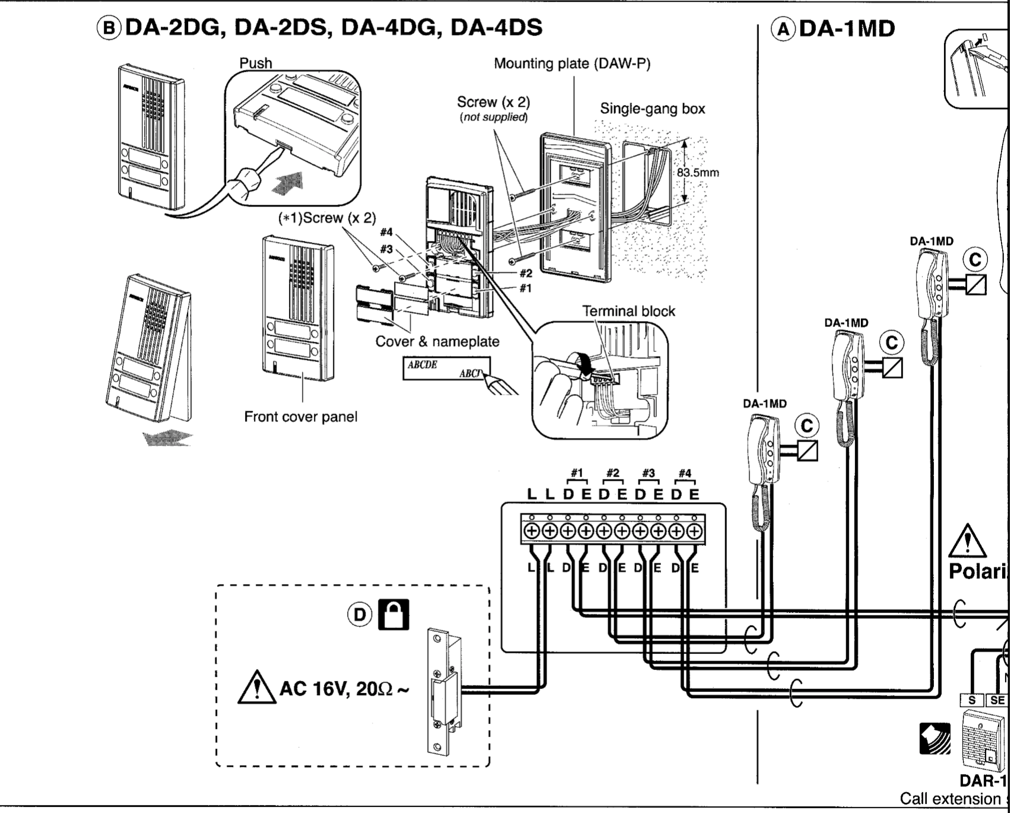
Tinkering

Slide 15



Limitations
DEMO

Slide 16

Get Creative

Slide 17

Does Anyone Have Experience?

Slide 18
IBM Watson

Slide 19
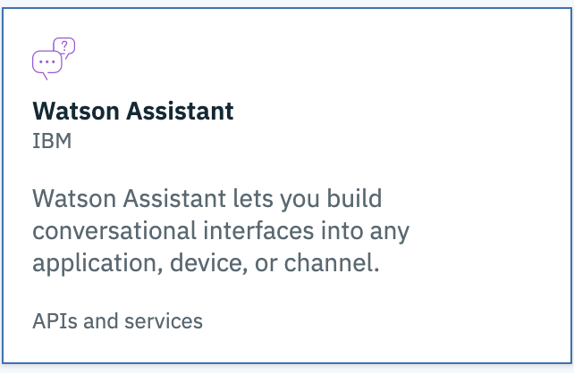
Watson Assistant
DEMO

Slide 20
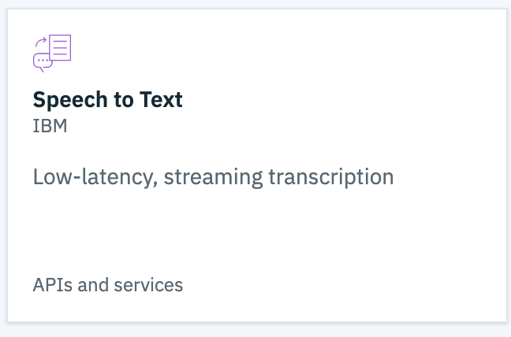
Watson Speech-to-Text
DEMO

Slide 21
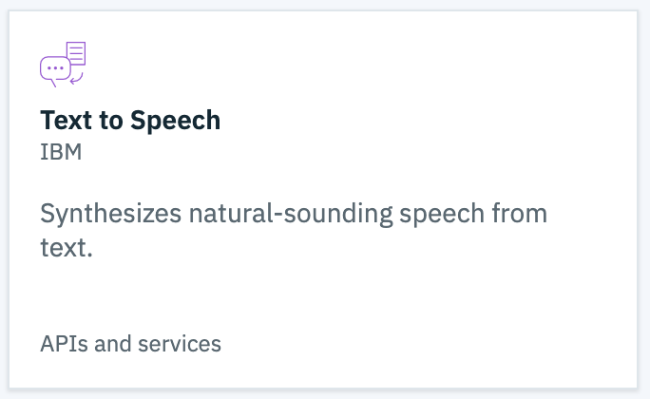
Watson Text-to-speech
DEMO

Slide 22
Environment

Slide 23
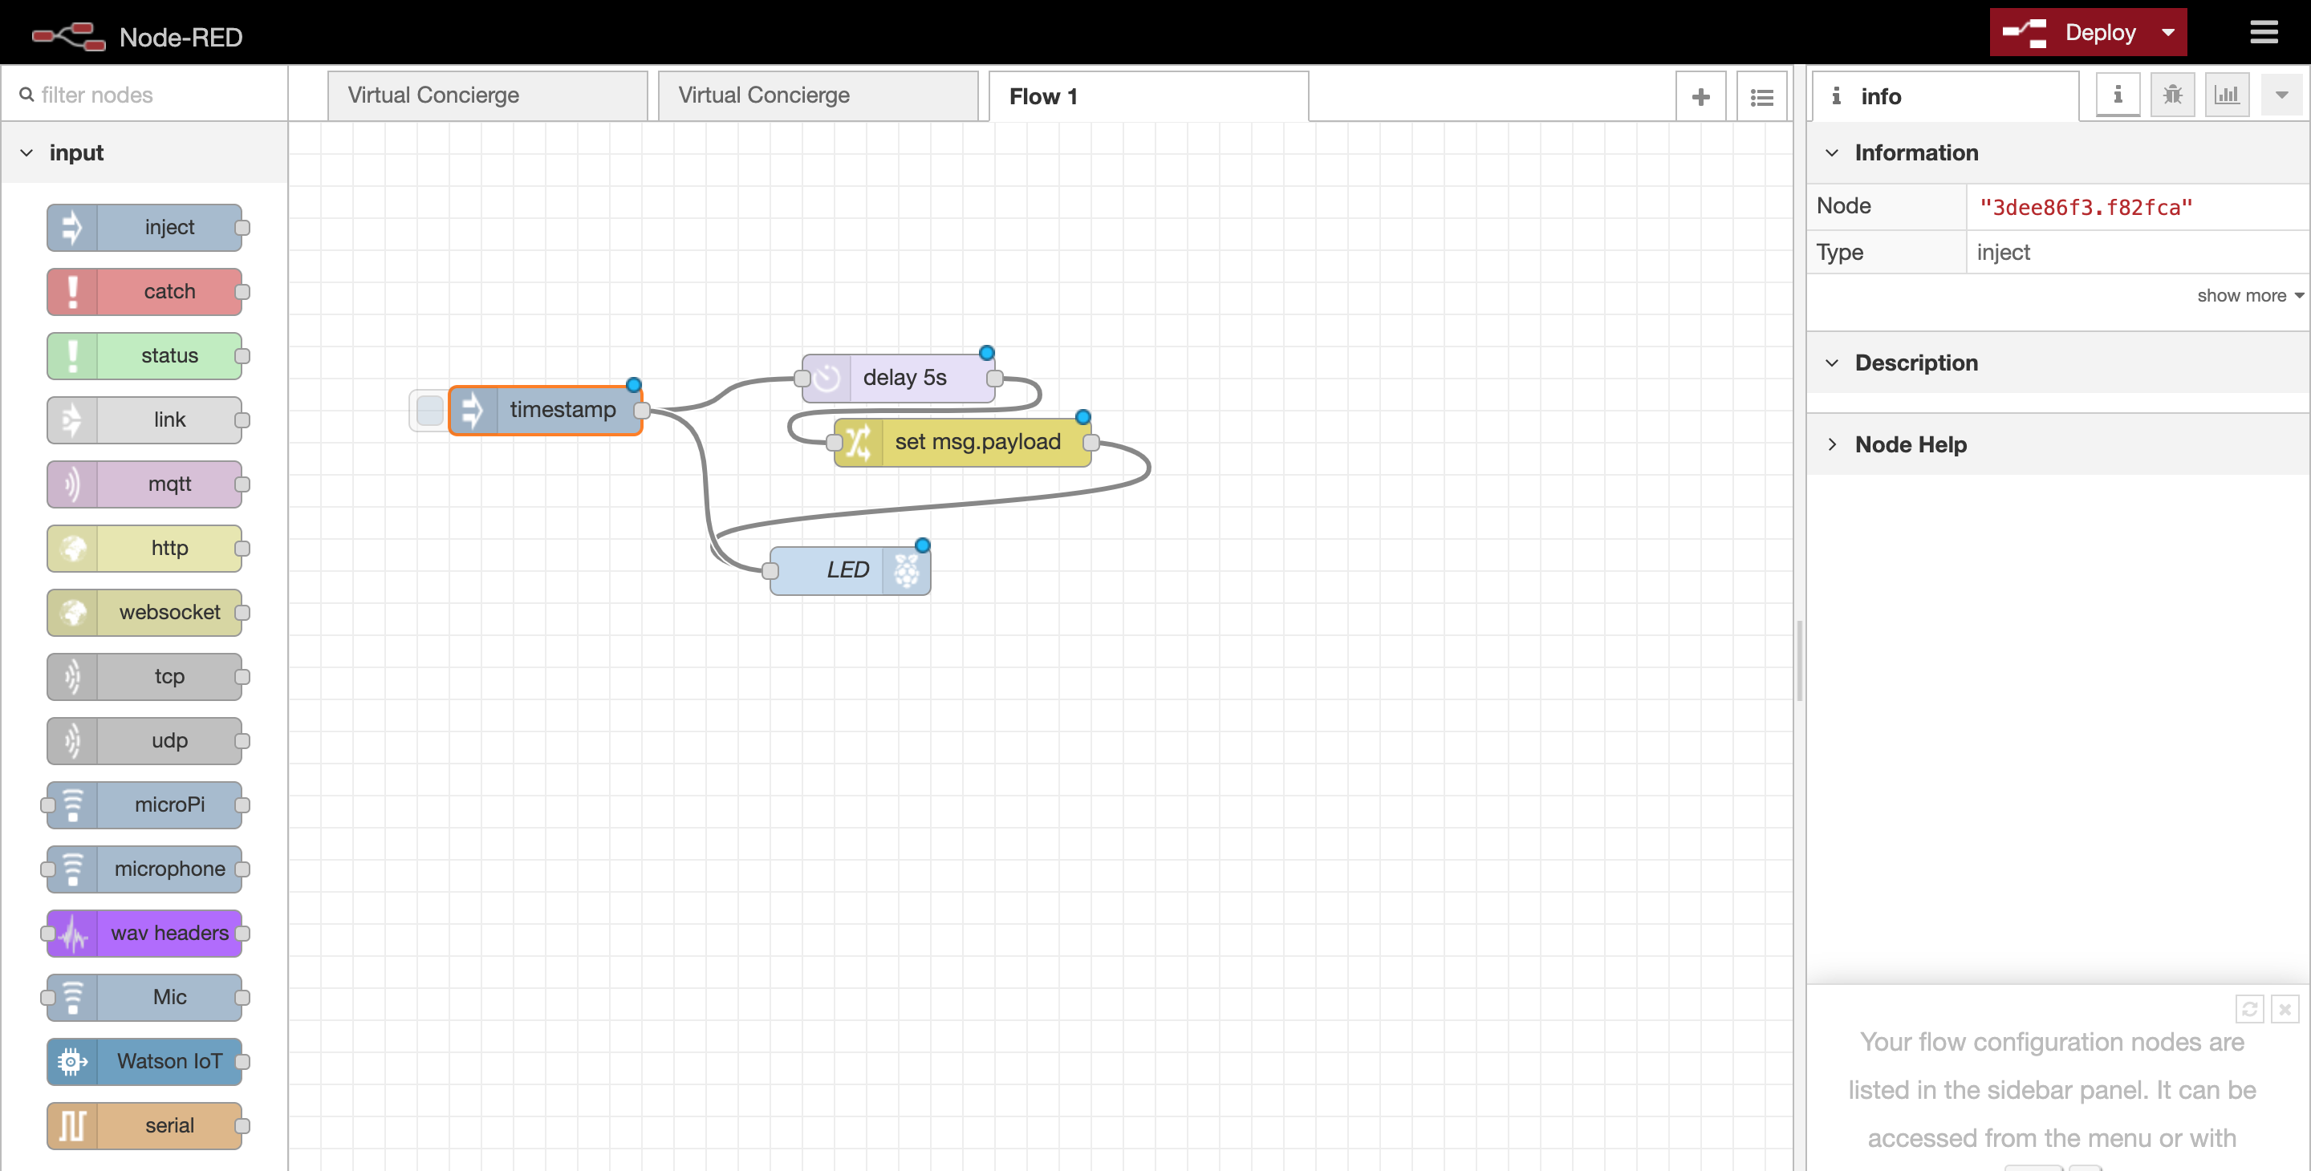

Slide 24
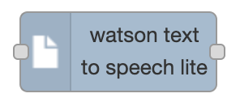
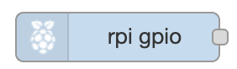

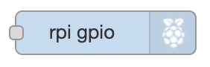
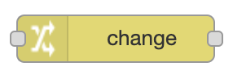


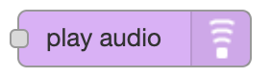


Different Nodes

Slide 25
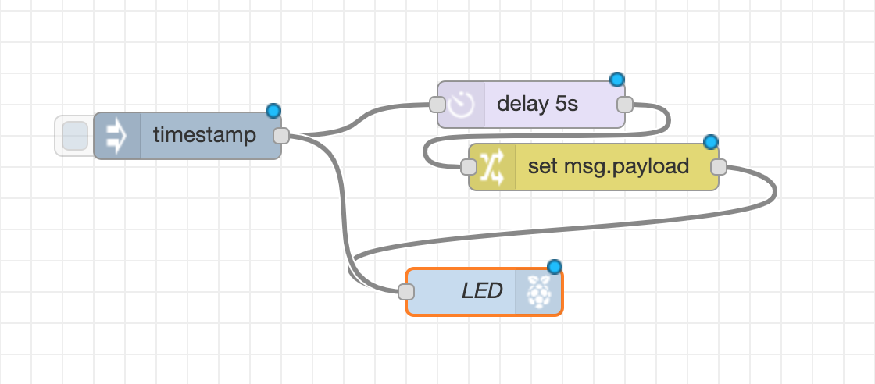
Flows

Slide 26
Side Bar

Slide 27
Info/Debugging Window

Slide 28
Using IBM Cloud

Slide 29
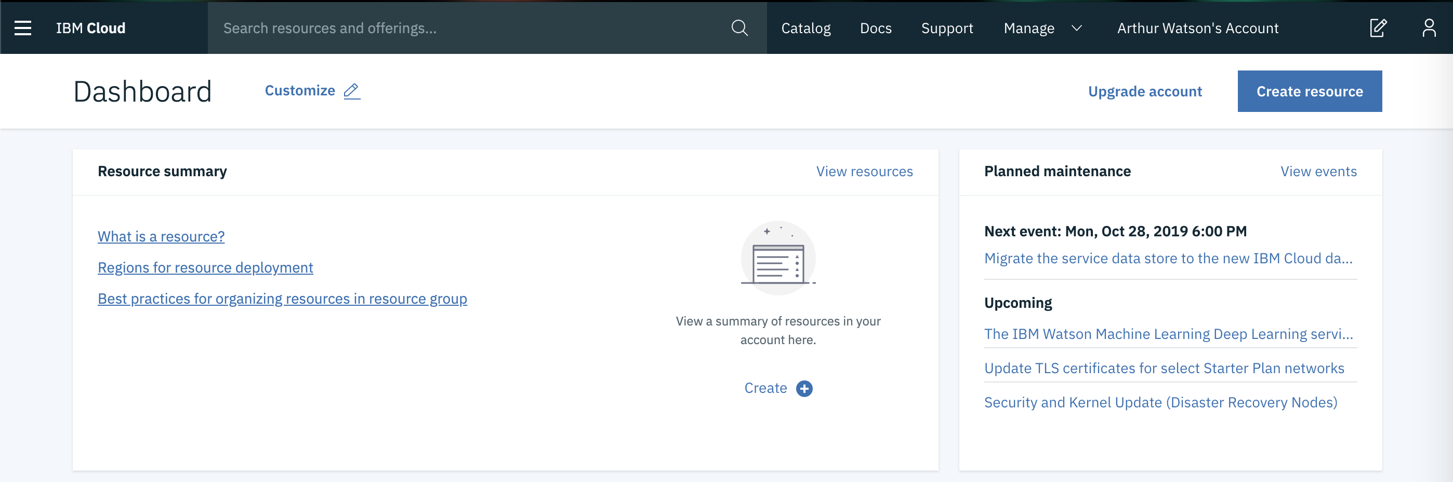
Ibm Cloud

Slide 30
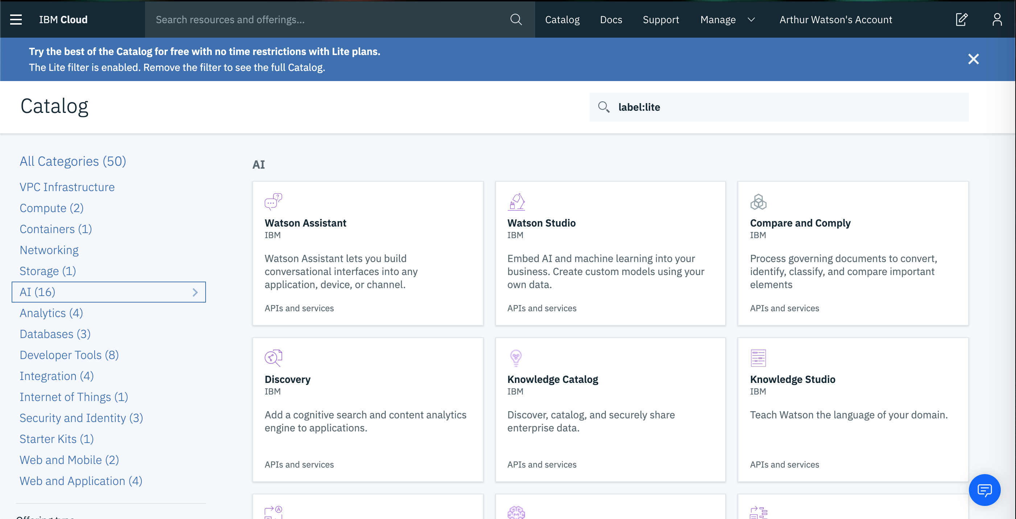

Slide 31
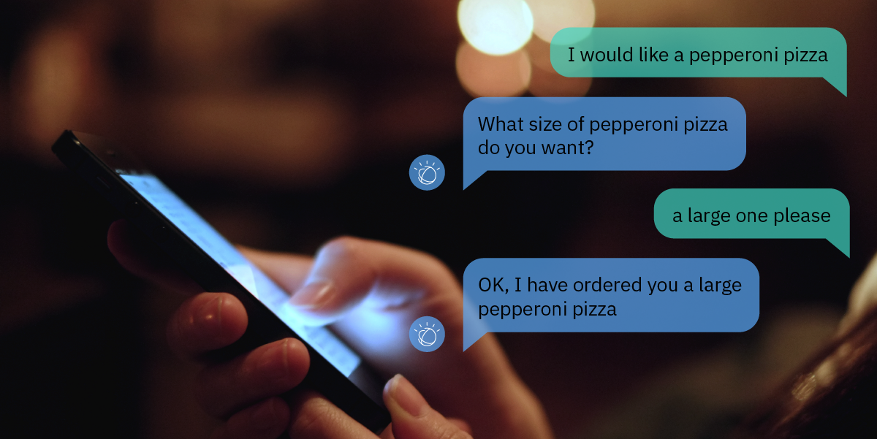
Making a chatbot

Slide 32
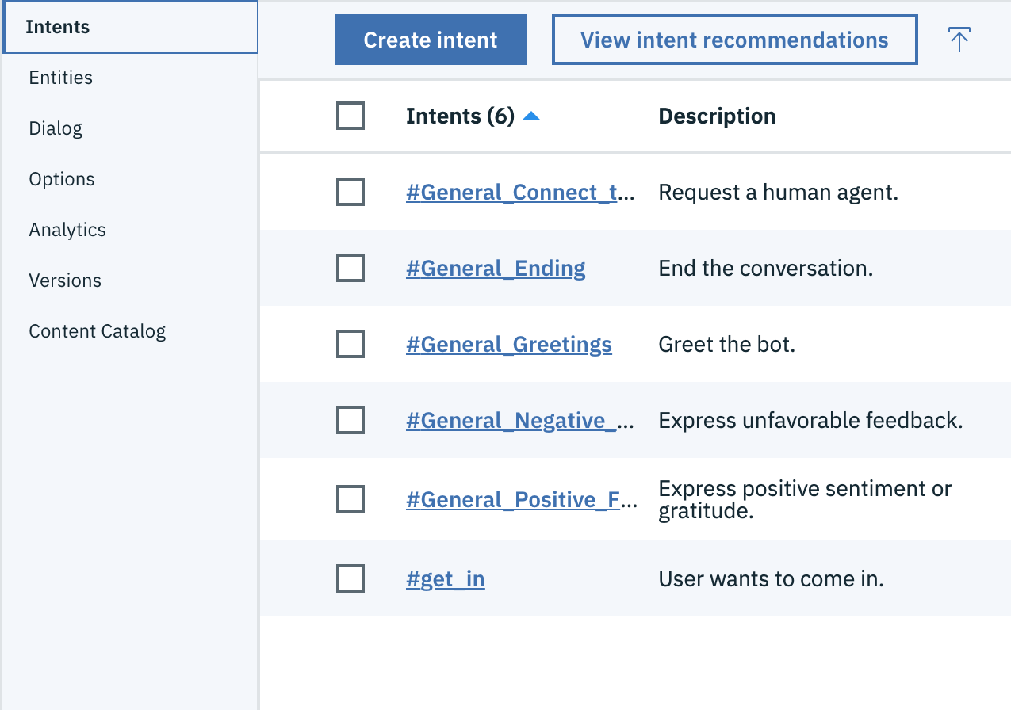
Intent
Intents are purposes or goals that are expressed in a customer's input

Slide 33
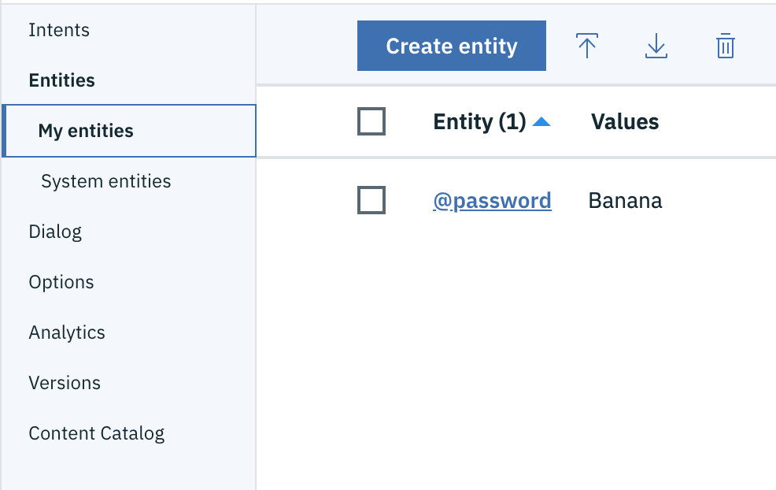
Entity
Looks for a Specific word the user said to Watson

Slide 34
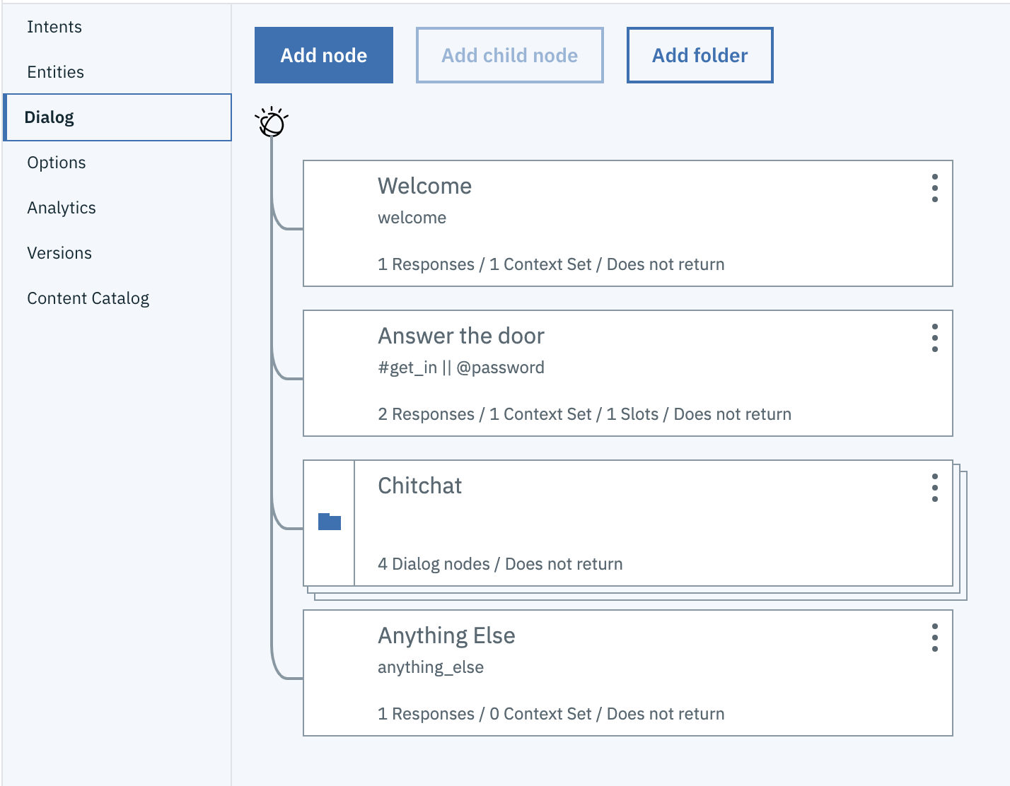
Dialog
The dialog uses the intents, entities, and context to provide feedback to the user

Slide 35
RECAp

Slide 36
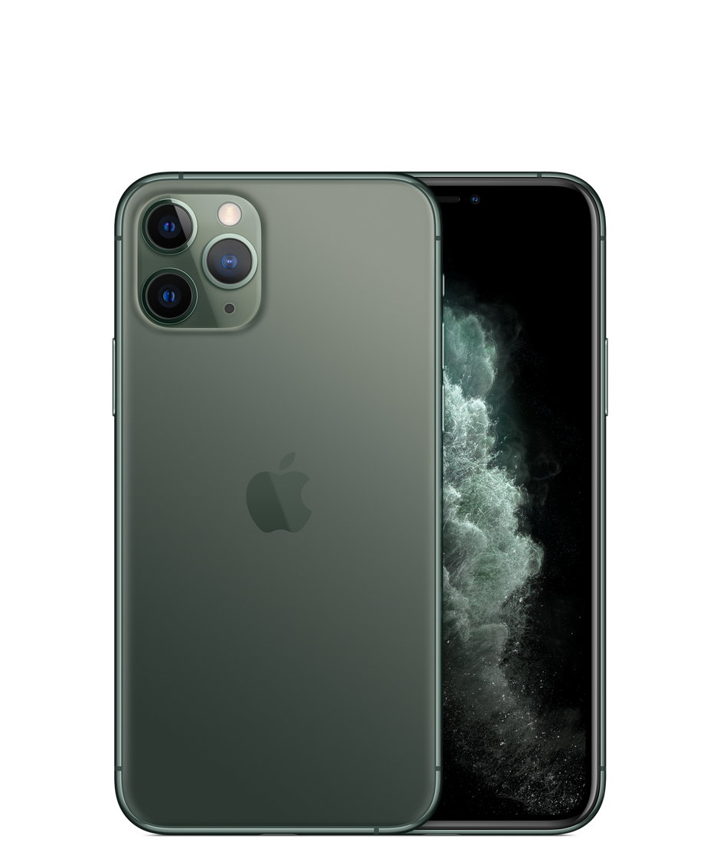



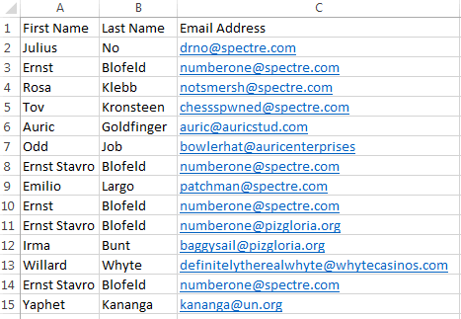
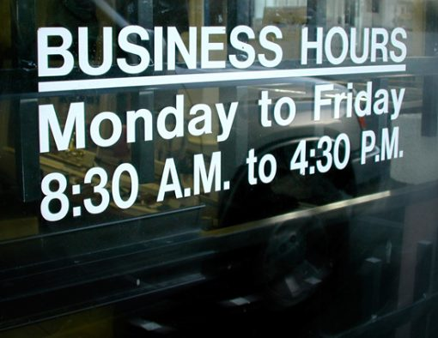
Other Ideas
Ask if open, or set a do not disturb.

Slide 37
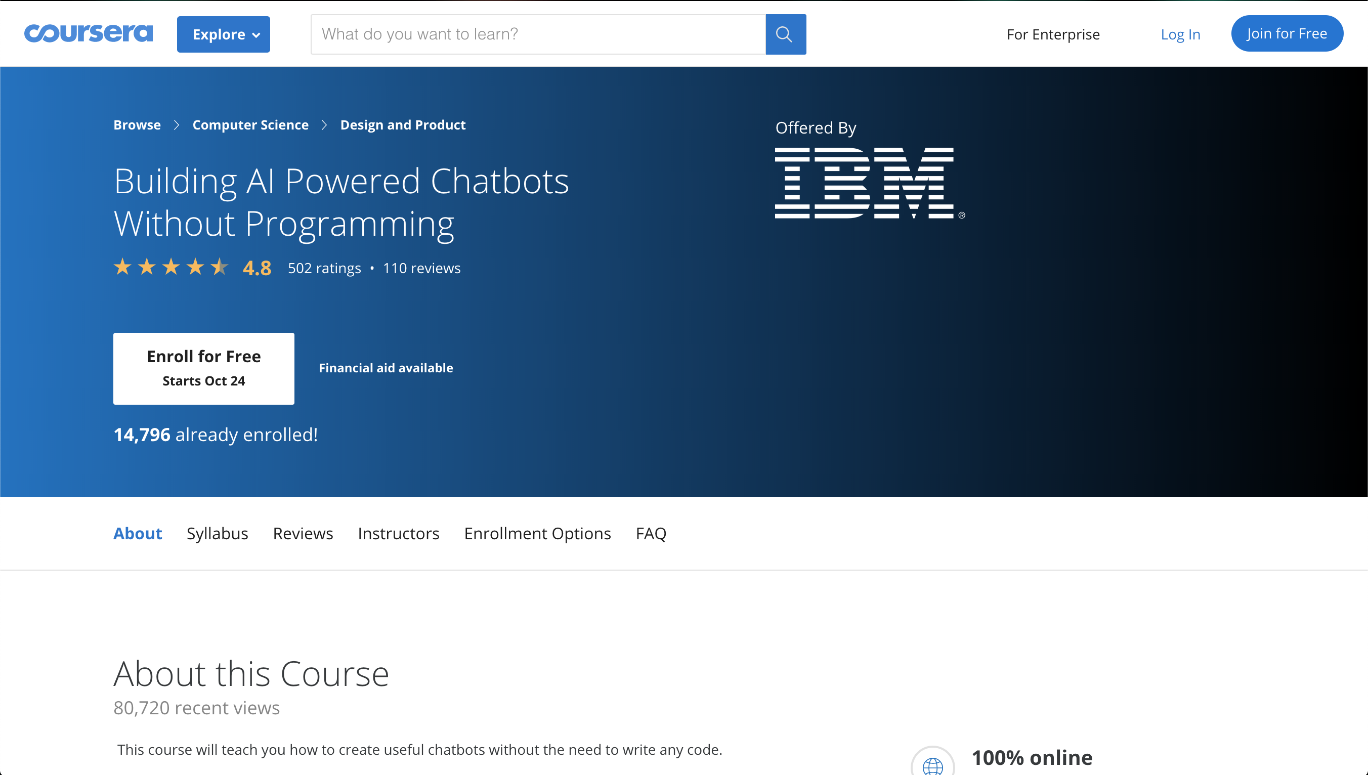

Slide 38
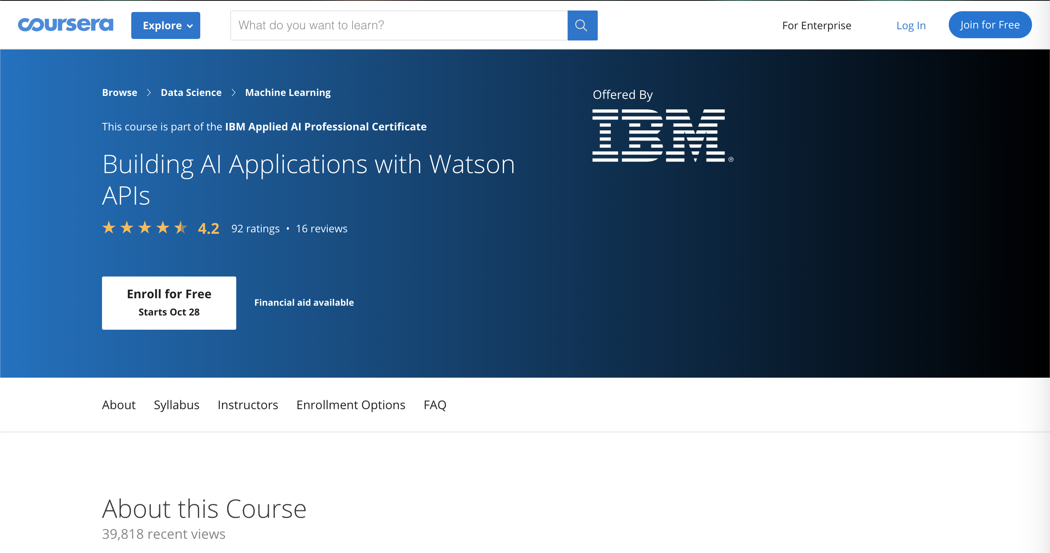
Other Resources

Slide 39


Slide 40
Contact Us
Eric Quan
Matthew Grech
https://www.linkedin.com/in/shengxu-quan1/
shengxu@ibm.com
https://www.linkedin.com/in/matthew-grech-6b6a56162/
mgrech@ibm.com

